Slide 1

Subsidiary Import Utility Tool
Deloitte Consulting India Pvt. Ltd.

Slide 2
Contents
Introduction 3
Features 4
Subsidiary Import utility User guide 5-10
Bundle Details 11
Post Installation Steps 12
GIT Repository Link 13
Business Benefits 14
Conclusion 15
Contacts 16

Slide 3
Introduction
Subsidiary Import Utility Tool
In every NetSuite project, the most common setup that we do is to configure the subsidiaries. NetSuite has no inbuilt capabilities to do Subsidiary Import. Each and every subsidiary must be manually created in all the environments in the UI which is a very much time consuming task. Keeping this in mind we came up with a solution to expedite the process of creating subsidiaries with a simple and easy solution.

Slide 4
Features
Subsidiary Import Utility Tool
Ability to import the subsidiaries using a CSV file.
Ability to download a sample CSV template and use the same for the upload.
Template will dynamically add all custom fields on the Subsidiary Object to the template.
Ability to update the subsidiary attributes.
Easy and user friendly User Interface

Slide 5
Subsidiary Import Utility
Operations user Guide

Slide 6
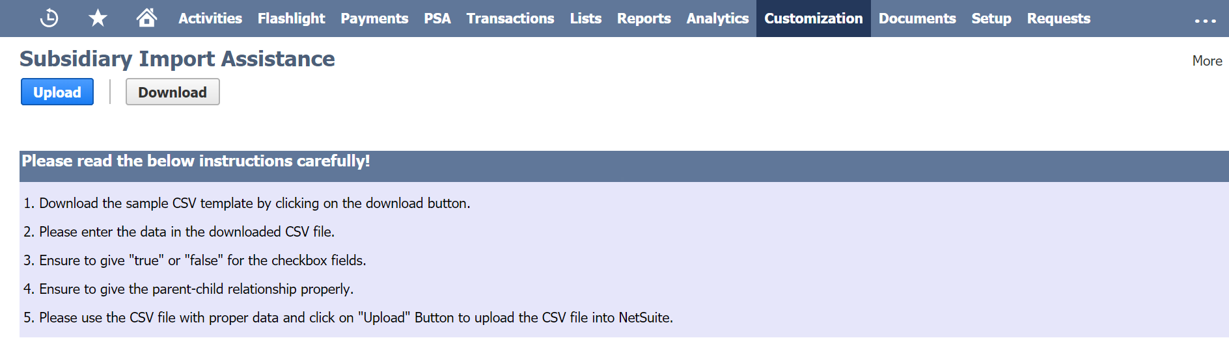
Subsidiary Import Utility Tool
Step 1: Download the template by clicking on the download button

Slide 7
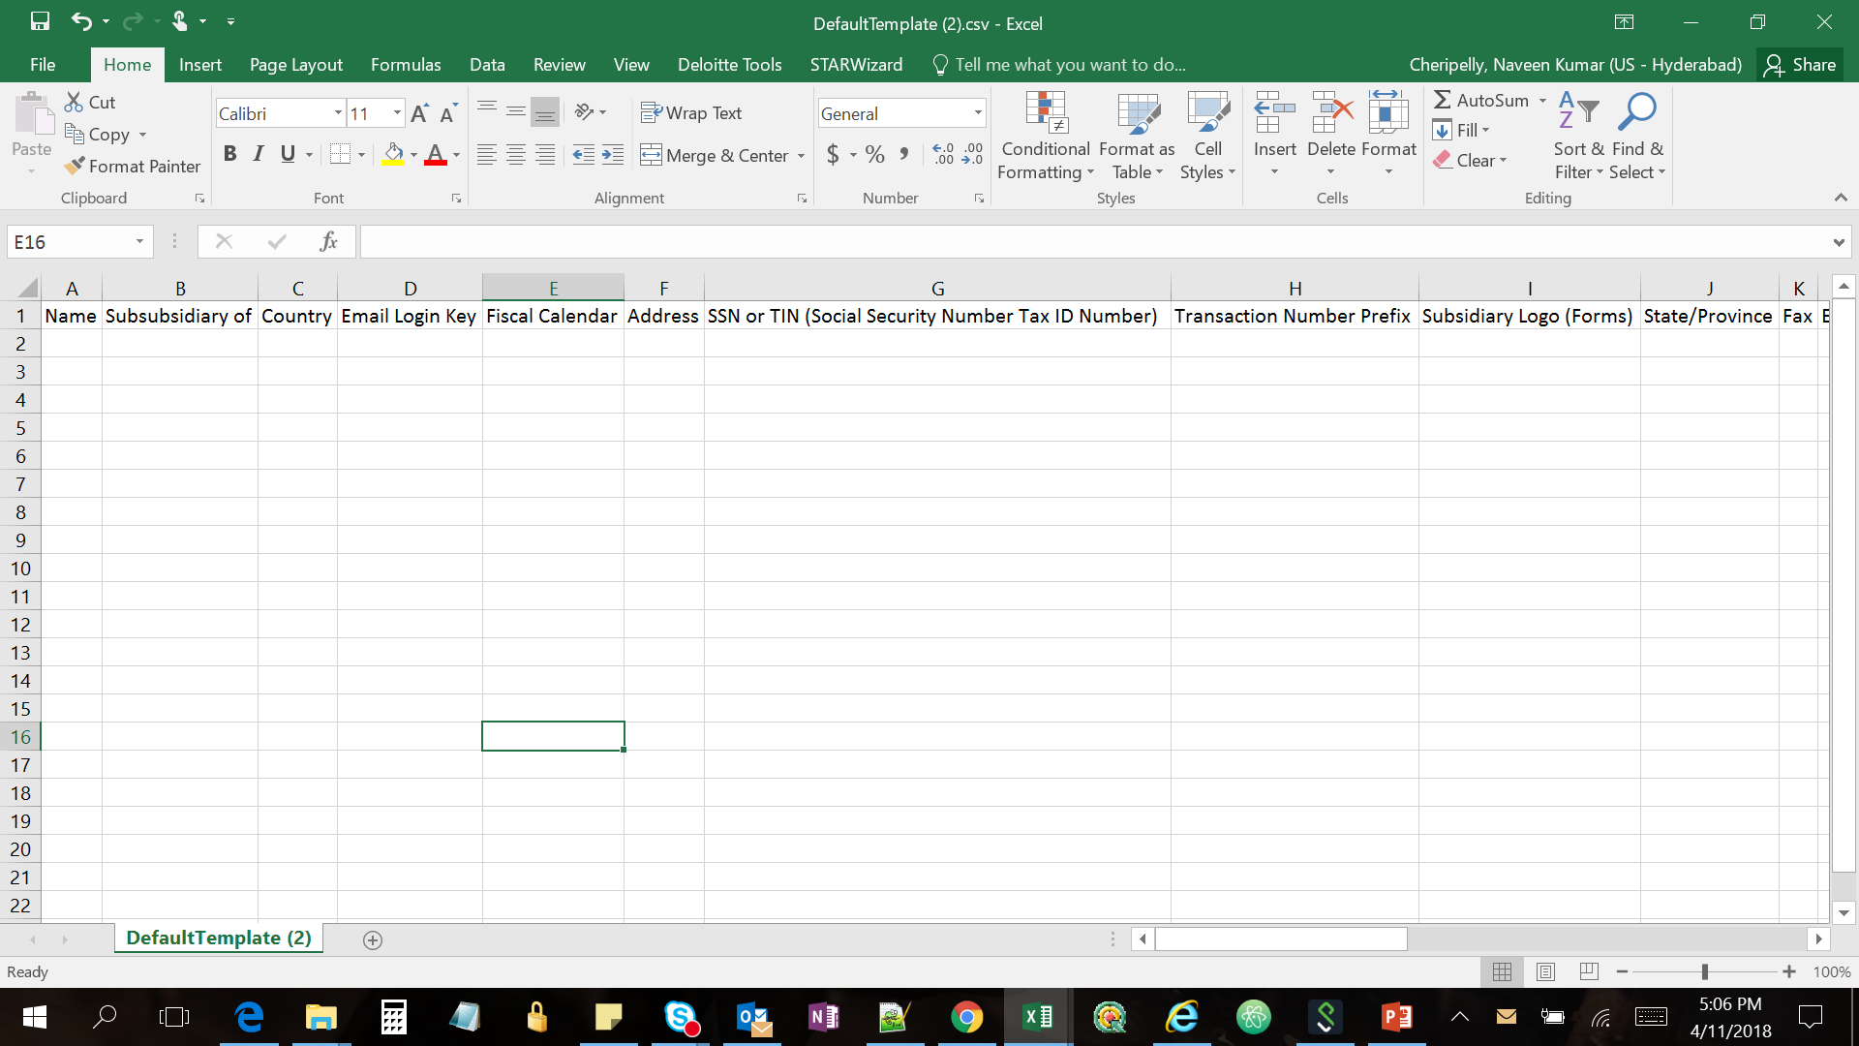
Subsidiary Import Utility Tool
Step 2: Fill the file downloaded as per the instructions provided

Slide 8
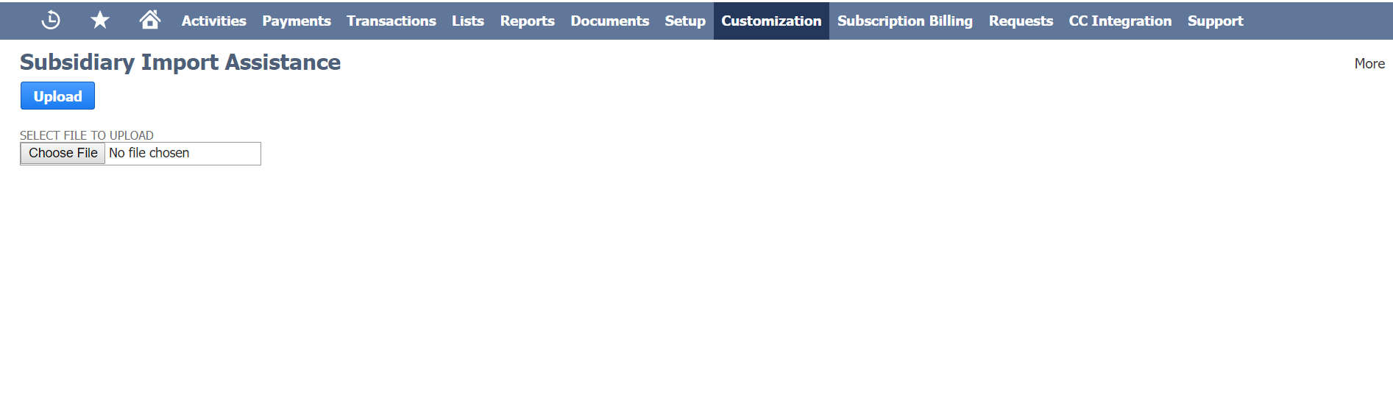
Subsidiary Import Utility Tool
Step 3: Upload the File

Slide 9
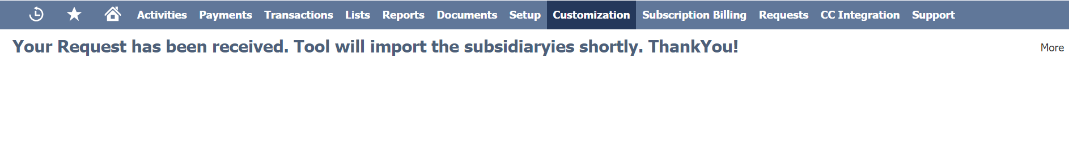
Subsidiary Import Utility Tool
On Successful Upload a confirmation message will appear as below

Slide 10
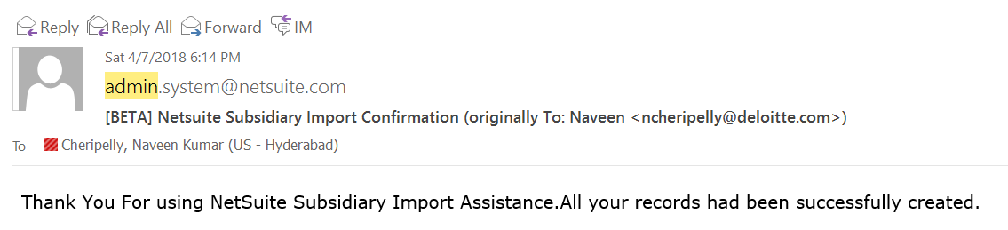
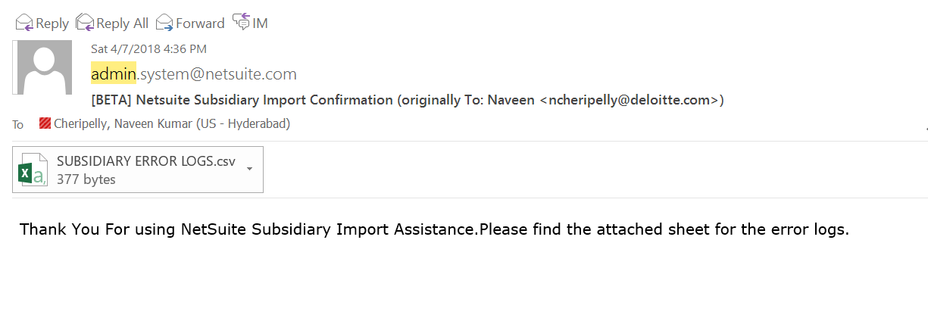
Subsidiary Import Utility Tool
A notification will be sent to the user for Successful/unsuccessful import of all subsidiary.

Slide 11
Bundle Details
Bundle Name :
SUBSIDIARY_IMPORT_ASSISTANCE
Path to Bundle : Customization > SuiteBundler > Create Bundle > List > SUBSIDIARY_IMPORT_ASSISTANCE
Account in which Bundle is present : Green Dot Auto Parts, Account ID: TSTDRV1151650

Slide 12
Post Installation Steps
After installing the bundle in the environment please cross check if the following scripts are in the environment and set the parameters as follows:
Map Reduce : NS MR Subsidiary Import
Keep the map reduce script in “not scheduled” status.
Set the following script parameters for the Map Reduce Script
Error Logs File Folder – Log the error files in this folder
Subsidiary internalid's File id - Upload Subsidiary Id file cabinet and set its internal Id here
State Internalid Fileid - Upload subsidiary ID in file cabinet and set its internal Id here
System Admin – Enter the Employee Record of the Admin who will get error details
(2) SuiteLet : Subsidiary Import Assistance
Set the following script parameter for the SuiteLet
Upload Documents Folder: Set the folder Internal Id from your environment

Slide 13
GIT Repository Link
https://github.com/anshulgupta4/SUBSIDIARYIMPORT

Slide 14
Business Benefits
Tool operation is very simple, anyone with NS account access can use it and no additional training is required
Built with native NetSuite Scripts – SuiteLet and Map/Reduce Scripts.
Uses multithreading/parallel processing therefore operation gets completed in shortest possible time, greatly reduces the data correction/data creation efforts thus helps in overall testing schedules, and other day to day business activities
Subsidiaries configuration status gets communicated to users through email notification for both successful/unsuccessful job run.

Slide 15
Conclusion
This solution uses proven components of Netsuite standard SuiteScript APIs to perform data operations. This tool is designed with user friendly interface where users can easily use this tool to perform import operation. This tool will enable the users to avoid manual configuration of subsidiaries thus reduces overall time to perform import operations without any errors. This tool mocks the behavior of the standard CSV Import feature of NetSuite. If the subsidiaries are successfully imported, user receives an email stating that import was successful and if the import is not successful, the user receives an email stating the cause of errors.

Slide 16
Contacts
For more information about this paper, please contact:
Deepak Agarwalla
Manager
Deloitte Consulting India Pvt. Ltd.
Bangalore, Karnataka
+1 (470) 434-5892 dagarwalla@deloitte.com
Madhur Rastogi
Manager
Deloitte Consulting India Pvt. Ltd.
Hyderabad, Telangana +1 (615) 718-7291 mrastogi@DELOITTE.com
Priyanka Aswini
Consultant
Deloitte Consulting India Pvt. Ltd.
Bangalore, Karnataka
+1 (470) 434-0467 apriyanka@deloitte.com
Naveen Cheripelly
Consultant
Deloitte Consulting India Pvt. Ltd.
Hyderabad, Telangana +1.678.336.3718 ncheripelly@deloitte.com
Anuradha Sinha
Consultant
Deloitte Consulting India Pvt. Ltd.
Bangalore, Karnataka
+1 (470) 434-0467 anurasinha@deloitte.com

Slide 17
Thank You

